Slide 1
Announcements
Homework 1 results posted and testcases are on DEN
Homework 2
You can solve it with any algorithm(s) you want
If something hasn't been described in the HW description as:
a limitation, it means that there is no limitation in that regard.
an assumption, it means that you cannot assume it.
So read it now and spend some time thinking about it

Slide 2
Exercise 8.10
Consider an ontology with the following symbols:
Occupation(p,o) : Person p has occupation o
Customer(p₁, p₂) : Person p₁ is a customer of person p₂
Boss(p₁, p₂) : Person p₁ is a boss of person p₂
Emily, Joe: Constants denoting people
Doctor, Surgeon, Lawyer, Actor: Constants denoting occupations
Use these symbols to express knowledge

Slide 3
a.
Emily is either a surgeon or a lawyer.
Emily is a surgeon: Occupation(Emily, Surgeon)
Emily is a lawyer: Occupation(Emily, Lawyer)
Occupation(Emily, Surgeon) ⋁ Occupation(Emily, Lawyer)

Slide 4
b.
Joe is an actor, but he also holds another job.
Joe is an actor: Occupation(Joe, Actor)
Joe holds another job: ∃x Occupation(Joe, x)
“but” is like “and” here
Occupation(Joe, Actor) ⋀ ∃x Occupation(Joe, x)
What if x is Actor?

Slide 5
b.
Joe is an actor, but he also holds another job.
Joe is an actor: Occupation(Joe, Actor)
Joe holds another job: ∃x Occupation(Joe, x) ⋀ ¬(x = Actor)
“but” is like “and” here
Occupation(Joe, Actor) ⋀ ∃x Occupation(Joe, x) ⋀ ¬(x = Actor)

Slide 6
c.
All surgeons are doctors.
Occupation(Surgeon,Doctor) ?
Not with our definition of Occupation(person,job)
All surgeons: ∀x Occupation(x, Surgeon)
Are doctors: Occupation(x,Doctor)
In other words, they are both surgeons and doctors
∀x Occupation(x, Surgeon) ⋀ Occupation(x, Doctor) ✘
But this says that everyone is a surgeon and doctor
∀x Occupation(x, Surgeon) ⇒ Occupation(x, Doctor) ✔
If someone is a surgeon, then s/he is also a doctor.

Slide 7
d.
Joe does not have a lawyer
There is no one who is a lawyer and has Joe as a customer
¬∃x (Occupation(x, Lawyer) ⋀ Customer(Joe, x))
Everyone either is not a lawyer or does not have Joe as a customer
∀x ( ¬Occupation(x, Lawyer) ⋁ ¬Customer(Joe, x))
If someone is a lawyer, s/he does not have Joe as a customer
∀x Occupation(x, Lawyer) ⇒ ¬Customer(Joe, x)

Slide 8
e.
Emily has a boss who is a lawyer.
Emily has a boss: Boss(x, Emily)
Who is a lawyer: Occupation(x, Lawyer)
∃x Boss(x, Emily) ⋀ Occupation(x, Lawyer) ✔
a boss
∀x Boss(x, Emily) ⇒ Occupation(x, Lawyer) ✘
every boss!
∃x Boss(x, Emily) ⇒ Occupation(x, Lawyer) ✘
true if there’s someone who is not Emily’s boss!

Slide 9
f.
There exists a lawyer all of whose customers are doctors.
There exists a lawyer: ∃x Occupation(x,Lawyer)
All of whose customers: ∀y Customer(y, x)
Are doctors: Occupation(y, Doctor)
∃x Occupation(x,Lawyer) ⋀ ∀y Customer(y, x) ⇒ Occupation(y, Doctor)

Slide 10
g.
Every surgeon has a lawyer.
Every surgeon: ∀x Occupation(x, Surgeon)
Has a lawyer: ∃y Occupation(y, Lawyer) ⋀ Customer(x, y)
There is someone who is a lawyer and has x as a customer
∀x Occupation(x, Surgeon) ⇒ ∃y Occupation(y, Lawyer) ⋀ Customer(x, y)
If someone is a surgeon, then ...

Slide 11
CSCI 561 Foundations of Artificial Intelligence Lecture 13: Inference in First-Order Logic (Chapter 8)
FALL 2018
Instructor:
Prof Sheila Tejada
cs561-l@mymaillists.usc.edu

Slide 12
Ground Literals
A ground literal’s terms are all ground terms.
A ground term is a term without variables.
These are all ground literals:
King(John)
On(Block₁, Table)
FatherOf(Leia, Lightsaber₃)
But these are not:
Customer(x, y)
FatherOf(y, Lightsaber₃)
Ground literals replace variables with constants
They behave just like propositional literals (i.e. Booleans).

Slide 13
Substitutions
Substitutions are mappings from terms to terms
θ₁ = { x/John, y/Leia, z/Lightsaber₃ }
θ₂ = { w/x, y/G(x), z/Lightsaber₃ }
SUBST(θ, α):
rewrite a sentence, α, by applying substitution, θ
Examples:
θ = { w/x, y/G(x), z/Lightsaber₃ }
SUBST(θ, ∀x Taller(Everest, z)) = Taller(Everest, Lightsaber₃)
SUBST(θ, ∀w, y Loves(w, y)) = Loves(x, G(x))
SUBST(θ, ∀y, z Owns(y, z)) = Owns(G(x), Lightsaber₃)

Slide 14
Universal Instantiation
Inference rule:
Given a sentence with universally quantified variables,
You can substitute a ground term for each variable.
Example: ∀x King(x) ∧ Greedy(x) ⇒ Evil(x)
We can replace x with any terms, including constants
{x/John}
{x/Leia}
∀v α
SUBST({v/g}, α)
∀x King(x) ∧ Greedy(x) ⇒ Evil(x)
King(John) ∧ Greedy(John) ⇒ Evil(John)
∀x King(x) ∧ Greedy(x) ⇒ Evil(x)
King(Leia) ∧ Greedy(Leia) ⇒ Evil(Leia)

Slide 15
Existential Instantiation
Inference rule:
Given a sentence with existentially quantified variables,
You can substitute a new constant for each variable.
Example: ∃x Crown(x) ∧ OnHead(x, John)
Skolemization: Replace x with a new constant
C₁ is a Skolem constant
∃v α
SUBST({v/k}, α)
∃x Crown(x) ∧ OnHead(x, John)
Crown(C₁) ∧ OnHead(C₁, John)

Slide 16
Propositionalization
Convert first-order KB into propositional KB
Ground literals behave just like propositional literals.
Existentially quantified sentence →one instantiation
Analogous to a disjunction
Universally quantified sentence →all possible instantiations
Analogous to a conjunction

Slide 17
Example 1
First-order knowledge base:
∃x Mammal(x) ∧ LaysEggs(x)
∀x Mammal(x) ⇒ WarmBlooded(x)
Mammal(Platypus)
¬WarmBlooded(Crocodile)
Propositionalization:
Mammal(EggLayer) ∧ LaysEggs(EggLayer)
Mammal(Platypus) ⇒ WarmBlooded(Platypus)
Mammal(Crocodile) ⇒ WarmBlooded(Crocodile)
Mammal(Platypus)
¬ WarmBlooded(Crocodile)
Terms
Platypus
Crocodile
17

Slide 18
Example 2
First-order knowledge base:
∀x . King(x) ∧ Greedy(x) ⇒ Evil(x)
King(John)
Greedy(John)
Brother(Richard, John)
Propositionalization: CNF
King(John) ∧ Greedy(John) ⇒ Evil(John) {¬P₁,¬P₂,P₃}
King(Richard) ∧ Greedy(Richard) ⇒ Evil(Richard) {¬P₄,¬P₅,P₆}
King(John) {P₁}
Greedy(John) {P₂}
Brother(Richard, John) {P₇}
Terms
John
Richard
18

Slide 19
Propositionalization (cont’d)
Every first-order KB can be propositionalized
The resulting propositional KB preserves entailment.
Ground sentence is entailed by new KB iff entailed by old KB.
Let’s use this process for inference
Propositionalize KB and query
Apply inference process
Return result

Slide 20
Inference
FOL KB after Propositionalization:
Mammal(EggLayer) ∧ LaysEggs(EggLayer)
Mammal(Platypus) ⇒ WarmBlooded(Platypus)
Mammal(Crocodile) ⇒ WarmBlooded(Crocodile)
Mammal(Platypus)
¬ WarmBlooded(Crocodile)
Simple Approach
Remove ∀ and ∃
Treat all first-order terms as simple symbols
Solve using resolution for propositional logic
Example: WarmBlooded(Platypus)?
¬ WarmBlooded(Platypus) ← Prove that there is a contradiction
Mammal(Platypus) ⇒ WarmBlooded(Platypus)
¬ Mammal(Platypus) ∨ WarmBlooded(Platypus)
¬ Mammal(Platypus)
Mammal(Platypus)
false
20

Slide 21
Problem 1: Exponential Space
Real problems involve lots of rules and lots of ground terms.
Have to enumerate every possible substitution for every universally quantified variable.
With 1,000 terms, ∀x,y Brother(x,y) has 1,000,000 instantiations.

Slide 22
Problem 1 (cont’d)
Propositionalization generates irrelevant sentences
∀x King(x) ∧ Greedy(x) ⇒ Evil(x)
King(John)
∀y Greedy(y)
Brother(Richard,John)
We can conclude that Evil(John)
But propositionalization also generates Greedy(Richard)
p k-ary predicates & n constants yield p·n^{k} instantiations.

Slide 23
Problem 2: Functions
Problem: Infinite Terms
Mammal(Steve)
Mammal(Mother(Steve))
Mammal(Mother(Mother(Steve)))
Solution: Iterative Deepening
Try proof with terms up to depth 1
Try proof with terms up to depth 2
…
Herbrand’s Theorem
If proof exists, this method will find it
Unfortunately, if not, we are in an infinite loop

Slide 24
Unification
Pick substitutions that will lead to new conclusions
Intuition: Try to make two expressions look the same.
For example, suppose you have the following 2 clauses:
(1) P(x, f(y)) ∨ Q(x, y)
(2) ¬P(g(u), v)
If we pick the substitution of θ = {x/g(u), v/f(y)}:
(3) P(g(u), f(y)) ∨ Q(g(u), y)
(4) ¬P(g(u), f(y))
Now we can apply the resolution rule to derive a new clause.
(5) Q(g(u), y)
Search eventually finds complementary literals.
Unification finds this substitution without the search.

Slide 25
Unify operator
Given: Two sentences s and t.
Return: A unifier of the two sentences with substitution θ such that
Unify(s, t) = θ where SUBST(θ, s) = SUBST(θ, t)
OR
FAIL if no substitution exists.
Examples:
Unify(Knows(John, x), Knows(John, Jane)) = {x/Jane}
Unify(Knows(John, x), Knows(y, Bill)) = {x/Bill, y/John}
Unify(Knows(John, x), Knows(y, Mother(y))) = {y/John, x/Mother(John)}
Unify(Knows(John, x), Knows(x, Elizabeth)) = FAIL
Unify(Knows(John, x), Knows(x₁₇, Elizabeth)) = {x/Elizabeth, x₁₇/John}
25

Slide 26
Unify: Example
P | Q | θ=UNIFY(P,Q)
Eats(Panda, y) | Eats(Panda, Leaves) | {y/Leaves}
Eats(Panda, y) | Eats(x, Pizza) | {x/Panda; y/Pizza}
Eats(Panda, y) | Eats(x, FavFood(x)) | {x/Panda; y/FavFood(Panda)}
26

Slide 27
Unify: More Examples
P | Q | θ
Student(x) | Student(Bob) | {x/Bob}
Sells(Bob, x) | Sells(x, Candy) | {x/Candy, x/Bob}
Is it correct?
27

Slide 28
Unify: More Examples
P | Q | θ
Student(x) | Student(Bob) | {x/Bob}
Sells(Bob, x) | Sells(y, Candy) | {x/Candy, y/Bob}
This is an example of standardizing apart one of the sentences being unified, by renaming it variables to avoid name clashes.
28

Slide 29
Rules for unifying terms
Unifies
C₁, C₁
x, C₁
x, y
F(C₁, x), F(C₁, C₂)
F(x), F(y)
x, F(y)
x = y, y = C₁
C₁ = x, x = y
Does not unify
C₁, C₂
F(x), G(x)
F(x), F(x, y)
x, F(x)
x = C₁, C₂ = x
29
C₁|C₂ = constant, x|y = variable, F|G = function symbol

Slide 30
Most General Unifier (MGU)
There may be more than one unifying substitution
Unify(Knows(John, x), Knows(y, z)) =
(1) {y/John, x/z}
(2) {y/John, x/John, z/John}
In both, y is John and x=z
But in (2), we can no longer change the values of x and z
Might make it harder for future unifications
For every unifiable pair of expressions there is a most general unifier (a unique substitution) that equates the pair while making the fewest restrictions on the values of the variables.

Slide 31
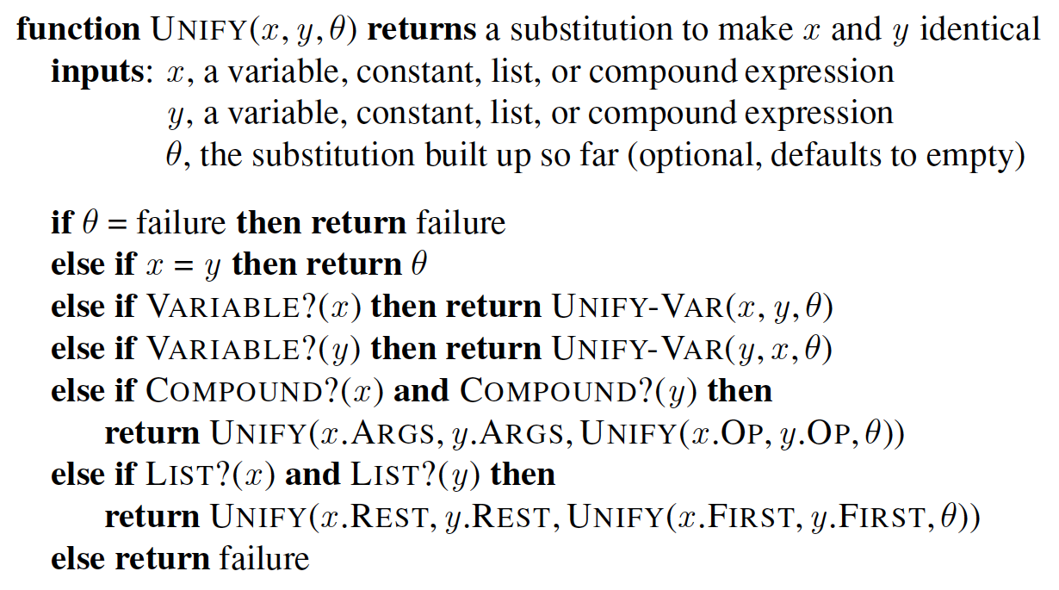
Unification Algorithm
31

Slide 32
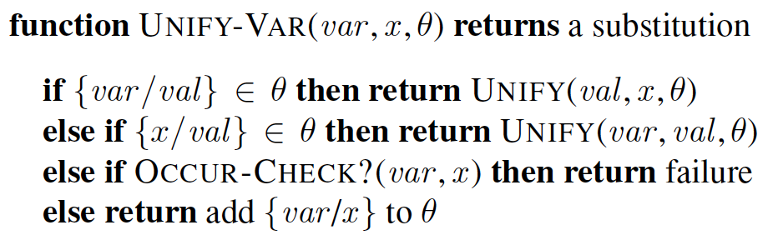
Unification Algorithm (Cont’d)
When matching a variable against a complex term, one must check if the variable itself occurs inside the term; if it does, the match fails because no consistent unifier can be constructed, e.g., S(x) can’t unify with S(S(x)).
Occur-Check increases the complexity of the algorithm.
Some systems, including all logic programming systems, simply omit the occur check and sometimes make unsound inferences as a result.
32

Slide 33
Generalized Modus Ponens
Modus Ponens
α ⇒ β, α
β
Unification allows us to quickly find the substitutions for universally quantified variables that will allow inference to proceed.
We can now write a new version of our Modus Ponens inference rule, where the substitution that unifies the antecedent is used to instantiate the consequent.
Where SUBST(θ, p_{i}ʹ) = SUBST(θ, p_{i}) for all i:
p₁ʹ, p₂ʹ, …, p_{n}ʹ, (p₁ ∧ p₂ ∧ … ∧ p_{n} ⇒ q)
SUBST(θ, q)
Generalized Modus Ponens is a lifted version of propositional Modus Ponens. We’ve used unification to keep our inference at the abstract level, rather than at the level of ground terms.
33

Slide 34
Example:
Modus Ponens
α ⇒ β, α
β
Generalized Modus Ponens
p₁ʹ, p₂ʹ, …, p_{n}ʹ, (p₁ ∧ p₂ ∧ … ∧ p_{n} ⇒ q)
SUBST(θ, q)
Where SUBST(θ, p_{i}ʹ) = SUBST(θ, p_{i}):
Example:
King(John), Greedy(y), (King(x) ∧ Greedy(x) ⇒ Evil(x))
Evil(John)
Where θ is {x/John, y/John}
34

Slide 35
Inference with Forward Chaining & Backward Chaining
35

Slide 36
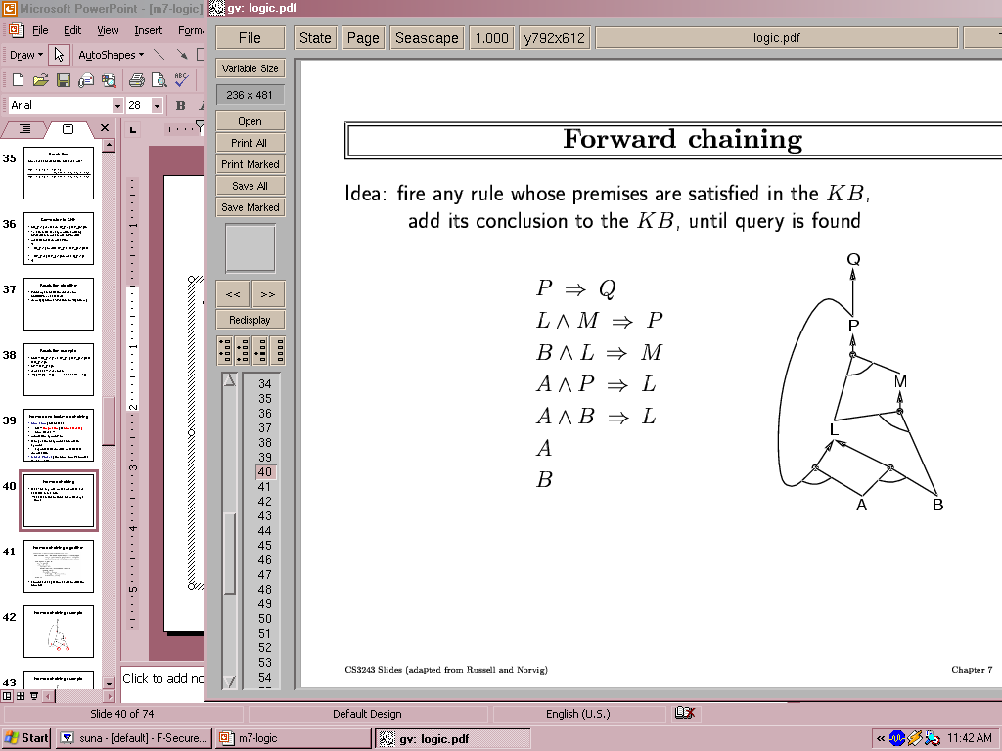
Forward chaining
Fire any rule whose premises are satisfied in the KB
Add its conclusion to the KB, until query is found
KB:
⋁
⋀
Query: Q
AND-OR Graph
36

Slide 37
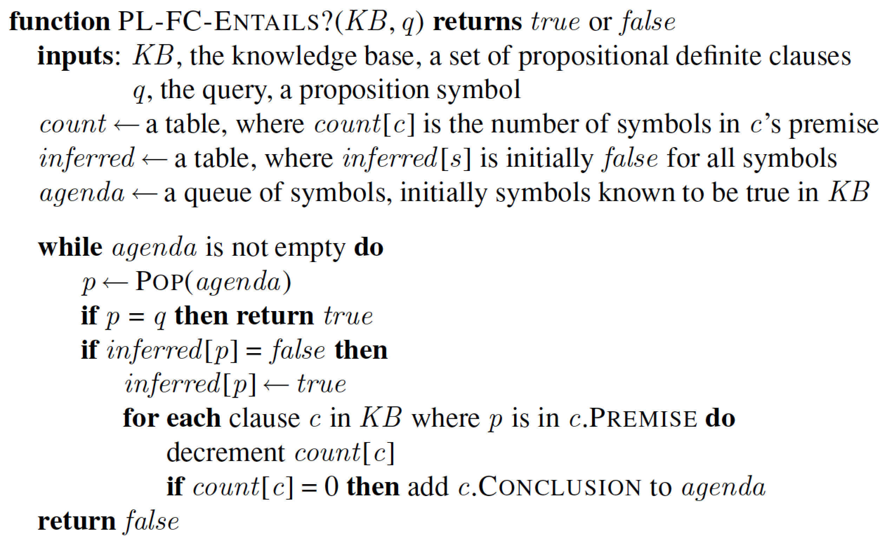
Forward chaining algorithm
Forward chaining is sound and complete for Horn KB
37

Slide 38
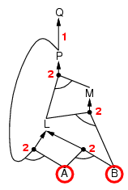
Forward Chaining: Example
38

Slide 39
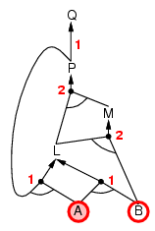
Forward Chaining: Example
39

Slide 40
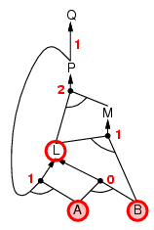
Forward Chaining: Example
40

Slide 41
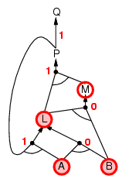
Forward Chaining: Example
41

Slide 42
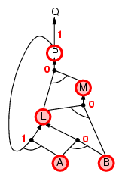
Forward Chaining: Example
42

Slide 43
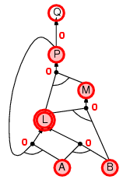
Forward Chaining: Example
43

Slide 44
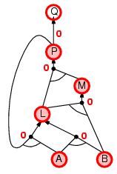
Forward Chaining: Example
44

Slide 45

Forward Chaining: Example
45

Slide 46
A FOL forward-chaining algorithm
p₁ʹ, p₂ʹ, …, p_{n}ʹ, (p₁ ∧ p₂ ∧ … ∧ p_{n} ⇒ q)
SUBST(θ, q)
Start from known facts.
If any set of facts satisfy the Generalized Modus Ponens rule, then
If the conclusion is a new, add it to the set of known facts.
Repeat 2-3 until no new facts are added.
Illustrate the application of forward-chaining algorithm with KB with definite clauses.
Sound, because every conclusion is just an application of Generalized Modus Ponens.
Complete for FOL knowledge bases of definite clauses.
46

Slide 47
First-order definite clauses
First-order definite clauses are disjunctions of literals, of which exactly one is positive.
We can view them as implications where the antecedent is a conjunction of positive literals, and the consequent is a single positive literal.
Atomic sentences (positive literals) are also definite clauses.
In FOL, definite clauses can include variables. The variables are assumed to be universally quantified. (∀ is often omitted in the writing.)
Example:
Mammal(Platypus) (Atomic sentence)
King(x) ∧ Greedy(x) ⇒ Evil(x) (implication form)
¬King(x) ∨ ¬Greedy(x) ∨ Evil(x) (definite clause form)
Note: Not all FOL KBs can be converted into a set of definite clauses.
47

Slide 48
Datalog Knowledge Base
Datalog Knowledge base contains only first-order definite clauses with no function symbols, e.g., the knowledge base on previous slide.
Datalog = FO definite clauses + no functions
It can represent the statements typically made in relational databases.
48

Slide 49
Example KB of definite clauses
“The law states that it is a crime for an American to sell weapons to hostile nations. The country Nono, an enemy of America, has some missiles, and all of its missiles were sold to it by Colonel West, who is an American.”
Apply Existential Instantiation to ∃x, Owns(Nono, x) ∧ Missile(x)
American(x) ∧ Weapon(y) ∧ Sells(x,y,z) ∧ Hostile(z) ⇒ Criminal(x) | “It is a crime for an American to sell weapons to hostile nations…”
Owns(Nono, M₁) ∧ Missile(M₁) | “Nono … has some missiles”
Missile(x) ∧ Owns(Nono, x) ⇒ Sells(West, x, Nono) | “All of its missiles were sold to it by Colonel West”
Missile(x) ⇒ Weapon(x) | “Missiles are weapons”
Enemy(x, America) ⇒ Hostile(x) | “Enemies of America are hostile”
American(West) | “West is an American”
Enemy(Nono, America) | “The country Nono is an enemy of America”
49

Slide 50
Was West a Criminal?
Before First iteration:
American(x) ∧ Weapon(y) ∧ Sells(x,y,z) ∧ Hostile(z) ⇒ Criminal(x)
Owns(Nono, M₁) ∧ Missile(M₁)
Missile(x) ∧ Owns(Nono, x) ⇒ Sells(West, x, Nono)
Missile(x) ⇒ Weapon(x)
Enemy(x, America) ⇒ Hostile(x)
American(West)
Enemy(Nono, America)
50

Slide 51
Was West a Criminal?
Before First iteration:
American(x) ∧ Weapon(y) ∧ Sells(x,y,z) ∧ Hostile(z) ⇒ Criminal(x)
Owns(Nono, M₁) ∧ Missile(M₁)
Missile(x) ∧ Owns(Nono, x) ⇒ Sells(West, x, Nono)
Missile(x) ⇒ Weapon(x)
Enemy(x, America) ⇒ Hostile(x)
American(West)
Enemy(Nono, America)
Ground sentences
51

Slide 52
Was West a Criminal?
First iteration:
Missile(x) ∧ Owns(Nono, x) ⇒ Sells(West, x, Nono) Unifies with Owns(Nono, M₁), Missile(M₁) {x/M₁} Add: Sells(West, M₁, Nono)
Missile(x) ⇒ Weapon(x) Unifies with Missile(M₁) {x/M₁} Add: Weapon(M₁)
Enemy(x, America) ⇒ Hostile(x) Unifies with Enemy(Nono, America) {x/Nono} Add: Hostile(Nono)
52

Slide 53
Was West a Criminal?
After First iteration:
American(x) ∧ Weapon(y) ∧ Sells(x,y,z) ∧ Hostile(z) ⇒ Criminal(x)
Owns(Nono, M₁) ∧ Missile(M₁)
Missile(x) ∧ Owns(Nono, x) ⇒ Sells(West, x, Nono)
Missile(x) ⇒ Weapon(x)
Enemy(x, America) ⇒ Hostile(x)
American(West)
Enemy(Nono, America)
Sells(West, M₁, Nono)
Weapon(M₁)
Hostile(Nono)
53

Slide 54
Was West a Criminal?
After First iteration:
American(x) ∧ Weapon(y) ∧ Sells(x,y,z) ∧ Hostile(z) ⇒ Criminal(x)
Owns(Nono, M₁) ∧ Missile(M₁)
Missile(x) ∧ Owns(Nono, x) ⇒ Sells(West, x, Nono)
Missile(x) ⇒ Weapon(x)
Enemy(x, America) ⇒ Hostile(x)
American(West)
Enemy(Nono, America)
Sells(West, M₁, Nono)
Weapon(M₁)
Hostile(Nono)
54

Slide 55
Was West a Criminal?
Second iteration:
American(x) ∧ Weapon(y) ∧ Sells(x,y,z) ∧ Hostile(z) ⇒ Criminal(x) Unifies with American(West), Weapon(M1), Sells(West,M1,Nono), Hostile(Nono) Add: Criminal(West)
55

Slide 56
Was West a Criminal?
After Second iteration:
American(x) ∧ Weapon(y) ∧ Sells(x,y,z) ∧ Hostile(z) ⇒ Criminal(x)
Owns(Nono, M₁) ∧ Missile(M₁)
Missile(x) ∧ Owns(Nono, x) ⇒ Sells(West, x, Nono)
Missile(x) ⇒ Weapon(x)
Enemy(x, America) ⇒ Hostile(x)
American(West)
Enemy(Nono, America)
Sells(West, M₁, Nono)
Weapon(M₁)
Hostile(Nono)
Criminal(West)
56

Slide 57
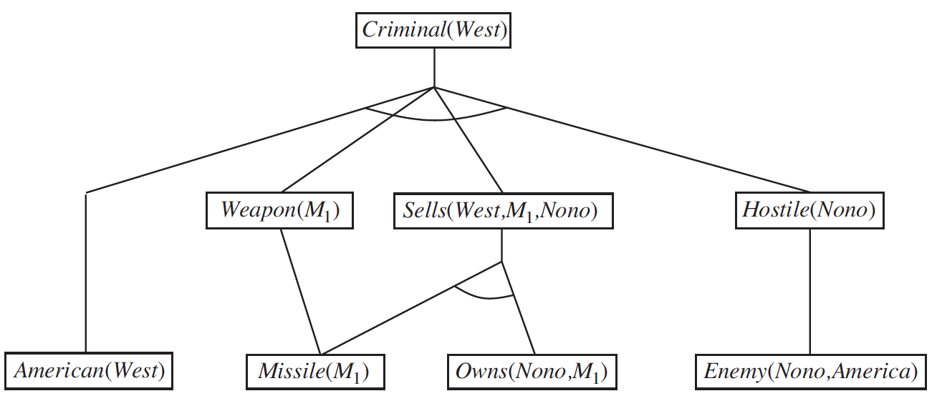
Was West a Criminal?
American(x) ∧ Weapon(y) ∧ Sells(x,y,z) ∧ Hostile(z) ⇒ Criminal(x)
Owns(Nono, M₁) ∧ Missile(M₁)
Missile(x) ∧ Owns(Nono, x) ⇒ Sells(West, x, Nono)
Missile(x) ⇒ Weapon(x)
Enemy(x, America) ⇒ Hostile(x)
American(West)
Enemy(Nono, America)
57

Slide 58
Was West a Criminal?
American(x) ∧ Weapon(y) ∧ Sells(x,y,z) ∧ Hostile(z) ⇒ Criminal(x)
Owns(Nono, M₁) ∧ Missile(M₁)
Missile(x) ∧ Owns(Nono, x) ⇒ Sells(West, x, Nono)
Missile(x) ⇒ Weapon(x)
Enemy(x, America) ⇒ Hostile(x)
American(West)
Enemy(Nono, America)
58

Slide 59
Was West a Criminal?
American(x) ∧ Weapon(y) ∧ Sells(x,y,z) ∧ Hostile(z) ⇒ Criminal(x)
Owns(Nono, M₁) ∧ Missile(M₁)
Missile(x) ∧ Owns(Nono, x) ⇒ Sells(West, x, Nono)
Missile(x) ⇒ Weapon(x)
Enemy(x, America) ⇒ Hostile(x)
American(West)
Enemy(Nono, America)
59

Slide 60
Properties of forward chaining
Sound and complete for first-order definite clauses
In Datalog KB, n constants, p predicates, max k arguments per predicate: Max facts p∙n^{k}, max iterations p∙n^{k}
In Datalog KB, FC terminates in finite number of iterations (e.g., p∙n^{k}), after which no new facts can be added (fixed point).
Because the search space spans the entire KB, a large KB must be organized in a manner to enable efficient searches.
60

Slide 61
Improving FC Efficiency – Pattern Matching
Missile(x) ∧ Owns(Nono, x) ⇒ Sells(West, x, Nono)
Find all objects owned by Nono, then check each object to see if it’s also a missile
Find all objects that are missiles, then check each object to see if it’s owned by Nono.
If the # of objects owned by Nono < # of missiles, then 1 is more efficient. Otherwise, 2 is more efficient.
Because all conjuncts of a rule must match, finding a good conjunct ordering can improve efficiency
Finding the optimal conjunct ordering is NP-hard
Good heuristics include Minimum-Remaining Values, used for CSPs can help
61

Slide 62
Improving FC Efficiency – Incremental FC
Each new fact inferred from current iteration must involve at least one inferred from last iteration, otherwise it would have been inferred during last iteration.
We can do incremental forward chaining – only consider rules with premise that involves a literal that can unify with the facts newly inferred from the previous iteration
62

Slide 63
Backward Chaining
Forward chaining: starts at KB, can generate a lot of irrelevant conclusions
Backward chaining: Work backwards from the query
Find all the implications where the premise includes the query
Prove all the premises of the implications
To Avoid loops
check if new subgoal is already on the goal stack
To avoid repeated work
check if new subgoal has already been proved true
63

Slide 64
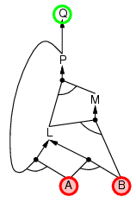
Backward Chaining: Example
64

Slide 65
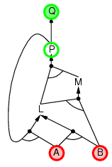
Backward Chaining: Example
65

Slide 66
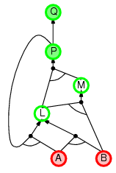
Backward Chaining: Example
66

Slide 67
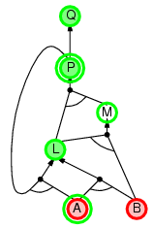
Backward Chaining: Example
67

Slide 68
FOL Backward chaining
Instead of forward-chaining from what we know to find what we want to know, let’s do the reverse:
Start with what we want to know, and backward-chain until we can prove it from things we already know. We are searching for a proof.
For example, we want to prove: Criminal(West)
Given our KB, we know of only one way to prove it:
American(x) ∧ Weapon(y) ∧ Sells(x,y,z) ∧ Hostile(z) ⇒ Criminal(x)
We can prove the consequent if we can find a proof for the antecedent.
Prove: American(West) ∧ Weapon(y) ∧ Sells(West,y,z) ∧ Hostile(z)
68

Slide 69
Backward Chaining Algorithm
Start with a knowledge base KB, and a desired conclusion c or question q.
Find all sentences that are answers to q in KB or proves c
If q is directly provable by premises in KB, infer q.
Find all implications that have q as a consequent.
For each of these implications, find whether all of its premises are now in the KB, in which case infer the consequent and add it to the KB. If necessary, attempt to prove the implication also via backward chaining
Premises that are conjuncts are processed one conjunct at a time
69

Slide 70
Was West a Criminal?
In the initial KB:
American(x) ∧ Weapon(y) ∧ Sells(x,y,z) ∧ Hostile(z) ⇒ Criminal(x)
Owns(Nono, M₁) ∧ Missile(M₁)
Missile(x) ∧ Owns(Nono, x) ⇒ Sells(West, x, Nono)
Missile(x) ⇒ Weapon(x)
Enemy(x, America) ⇒ Hostile(x)
American(West)
Enemy(Nono, America)
70

Slide 71
Example
American(x) ∧ Weapon(y) ∧ Sells(x,y,z) ∧ Hostile(z) ⇒ Criminal(x)
Owns(Nono, M₁) ∧ Missile(M₁)
Missile(x) ∧ Owns(Nono, x) ⇒ Sells(West, x, Nono)
Missile(x) ⇒ Weapon(x)
Enemy(x, America) ⇒ Hostile(x)
American(West)
Enemy(Nono, America)
Criminal(West)
71
We want to prove that West was a criminal

Slide 72
Example
American(x) ∧ Weapon(y) ∧ Sells(x,y,z) ∧ Hostile(z) ⇒ Criminal(x)
Owns(Nono, M₁) ∧ Missile(M₁)
Missile(x) ∧ Owns(Nono, x) ⇒ Sells(West, x, Nono)
Missile(x) ⇒ Weapon(x)
Enemy(x, America) ⇒ Hostile(x)
American(West)
Enemy(Nono, America)
Criminal(West)
American(West)
Weapon(y)
Sells(West, y, z)
Hostile(z)
72
This goal unifies with the consequent of only one rule in our KB. After substitution {x/West}, we need to prove four new conjuncts in the premise of the rule.

Slide 73
Example
American(x) ∧ Weapon(y) ∧ Sells(x,y,z) ∧ Hostile(z) ⇒ Criminal(x)
Owns(Nono, M₁) ∧ Missile(M₁)
Missile(x) ∧ Owns(Nono, x) ⇒ Sells(West, x, Nono)
Missile(x) ⇒ Weapon(x)
Enemy(x, America) ⇒ Hostile(x)
American(West)
Enemy(Nono, America)
Criminal(West)
American(West)
Weapon(y)
Sells(West, y, z)
Hostile(z)
{ }
73
The first conjunct is already a fact in our KB – American(West). It unifies with this fact with no substitutions.

Slide 74
Example
American(x) ∧ Weapon(y) ∧ Sells(x,y,z) ∧ Hostile(z) ⇒ Criminal(x)
Owns(Nono, M₁) ∧ Missile(M₁)
Missile(x) ∧ Owns(Nono, x) ⇒ Sells(West, x, Nono)
Missile(x) ⇒ Weapon(x)
Enemy(x, America) ⇒ Hostile(x)
American(West)
Enemy(Nono, America)
Criminal(West)
American(West)
Weapon(y)
Sells(West, y, z)
Hostile(z)
{ }
Missile(y)
74
The second conjunct unifies with the consequent of another rule in our KB – Missile(x) ⇒ Weapon(x). The antecedent of this rule is added as a subgoal.

Slide 75
Example
American(x) ∧ Weapon(y) ∧ Sells(x,y,z) ∧ Hostile(z) ⇒ Criminal(x)
Owns(Nono, M₁) ∧ Missile(M₁)
Missile(x) ∧ Owns(Nono, x) ⇒ Sells(West, x, Nono)
Missile(x) ⇒ Weapon(x)
Enemy(x, America) ⇒ Hostile(x)
American(West)
Enemy(Nono, America)
Criminal(West)
American(West)
Weapon(y)
Sells(West, y, z)
Hostile(z)
{ }
Missile(y)
{y/M₁}
75
This antecedent unifies with one fact in our KB – Missile(M₁). This unification produces a new substitution, {y/M₁}

Slide 76
Example
American(x) ∧ Weapon(y) ∧ Sells(x,y,z) ∧ Hostile(z) ⇒ Criminal(x)
Owns(Nono, M₁) ∧ Missile(M₁)
Missile(x) ∧ Owns(Nono, x) ⇒ Sells(West, x, Nono)
Missile(x) ⇒ Weapon(x)
Enemy(x, America) ⇒ Hostile(x)
American(West)
Enemy(Nono, America)
Criminal(West)
American(West)
Weapon(M₁)
Sells(West, M₁, z)
Hostile(z)
{ }
Missile(M₁)
{y/M₁}
76
We instantiate this substitution for subsequent subgoals.

Slide 77
Example
American(x) ∧ Weapon(y) ∧ Sells(x,y,z) ∧ Hostile(z) ⇒ Criminal(x)
Owns(Nono, M₁) ∧ Missile(M₁)
Missile(x) ∧ Owns(Nono, x) ⇒ Sells(West, x, Nono)
Missile(x) ⇒ Weapon(x)
Enemy(x, America) ⇒ Hostile(x)
American(West)
Enemy(Nono, America)
Criminal(West)
American(West)
Weapon(M₁)
Sells(West, M₁, z)
Hostile(z)
{ }
{z/Nono}
Missile(M₁)
{y/M₁}
The third conjunct unifies with the consequence of one rule in the KB. This unification creates new substitutions: {z/Nono} for Sells(West, M₁, z) and {x/M₁} for Sells(West, x, Nono).
77

Slide 78
Example
American(x) ∧ Weapon(y) ∧ Sells(x,y,z) ∧ Hostile(z) ⇒ Criminal(x)
Owns(Nono, M₁) ∧ Missile(M₁)
Missile(x) ∧ Owns(Nono, x) ⇒ Sells(West, x, Nono)
Missile(x) ⇒ Weapon(x)
Enemy(x, America) ⇒ Hostile(x)
American(West)
Enemy(Nono, America)
Criminal(West)
American(West)
Weapon(M₁)
Sells(West, M₁, Nono)
Hostile(Nono)
{ }
{z/Nono}
Missile(M₁)
Missile(M₁)
Owns(Nono,M₁)
{y/M₁}
78
The antecedent of the rule is added as subgoals. The subgoals are instantiated with the substitutions.

Slide 79
Example
American(x) ∧ Weapon(y) ∧ Sells(x,y,z) ∧ Hostile(z) ⇒ Criminal(x)
Owns(Nono, M₁) ∧ Missile(M₁)
Missile(x) ∧ Owns(Nono, x) ⇒ Sells(West, x, Nono)
Missile(x) ⇒ Weapon(x)
Enemy(x, America) ⇒ Hostile(x)
American(West)
Enemy(Nono, America)
Criminal(West)
American(West)
Weapon(M₁)
Sells(West, M₁, Nono)
Hostile(Nono)
{ }
{z/Nono}
Missile(M₁)
Missile(M₁)
Owns(Nono,M₁)
{y/M₁}
{ }
{ }
79
Both of the new conjuncts in the antecedent unify with facts in the KB, without substitution.

Slide 80
Example
American(x) ∧ Weapon(y) ∧ Sells(x,y,z) ∧ Hostile(z) ⇒ Criminal(x)
Owns(Nono, M₁) ∧ Missile(M₁)
Missile(x) ∧ Owns(Nono, x) ⇒ Sells(West, x, Nono)
Missile(x) ⇒ Weapon(x)
Enemy(x, America) ⇒ Hostile(x)
American(West)
Enemy(Nono, America)
Criminal(West)
American(West)
Weapon(M₁)
Sells(West, M₁, Nono)
Hostile(Nono)
{ }
{z/Nono}
Missile(M₁)
Missile(M₁)
Owns(Nono,M₁)
{y/M₁}
{ }
{ }
80
The fourth conjunct unifies with the consequence of one rule in the KB with substitute {x/Nono} for Hostile(x) in Enemy(x, America) ⇒ Hostile(x).

Slide 81
Example
American(x) ∧ Weapon(y) ∧ Sells(x,y,z) ∧ Hostile(z) ⇒ Criminal(x)
Owns(Nono, M₁) ∧ Missile(M₁)
Missile(x) ∧ Owns(Nono, x) ⇒ Sells(West, x, Nono)
Missile(x) ⇒ Weapon(x)
Enemy(x, America) ⇒ Hostile(x)
American(West)
Enemy(Nono, America)
Criminal(West)
American(West)
Weapon(M₁)
Sells(West, M₁, Nono)
Hostile(Nono)
{ }
{z/Nono}
Missile(M₁)
Missile(M₁)
Owns(Nono,M₁)
Enemy(Nono, America)
{y/M₁}
{ }
{ }
81
The antecedent of the rule is added as a subgoal. The subgoal is instantiated with the substitution {x/Nono}.

Slide 82
Example
American(x) ∧ Weapon(y) ∧ Sells(x,y,z) ∧ Hostile(z) ⇒ Criminal(x)
Owns(Nono, M₁) ∧ Missile(M₁)
Missile(x) ∧ Owns(Nono, x) ⇒ Sells(West, x, Nono)
Missile(x) ⇒ Weapon(x)
Enemy(x, America) ⇒ Hostile(x)
American(West)
Enemy(Nono, America)
Criminal(West)
American(West)
Weapon(M₁)
Sells(West, M₁, Nono)
Hostile(Nono)
{ }
{z/Nono}
Missile(M₁)
Missile(M₁)
Owns(Nono,M₁)
Enemy(Nono, America)
{y/M₁}
{ }
{ }
{ }
82
The new antecedent unifies with a fact in our KB without substitution. With all conjuncts in all antecedents satisfied, we have proven that Criminal(West).

Slide 83
Backward Chaining
Space: linear in size of proof, e.g., the size of the tree needed for the proof (depth-first recursive proof search)
Soundness: Yes (uses Generalized Modus Ponens)
Completeness: Incomplete due to infinite loops.
Can be inefficient due to repeated subgoals.
Caching of previous results requires extra space.
Widely used for logic programming
83

Slide 84
Next Time
Inference continued:
Resolution Theorem Proving
More general logical inference

